Slide 1

Marketing Consistent.
Lead expanded.
Clients happy.
Work simplified.

Slide 2








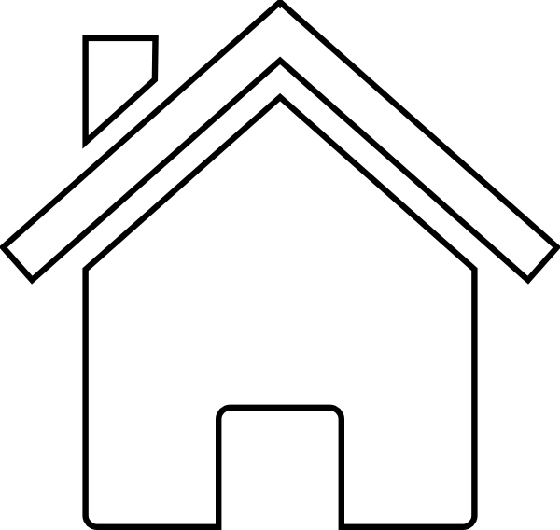
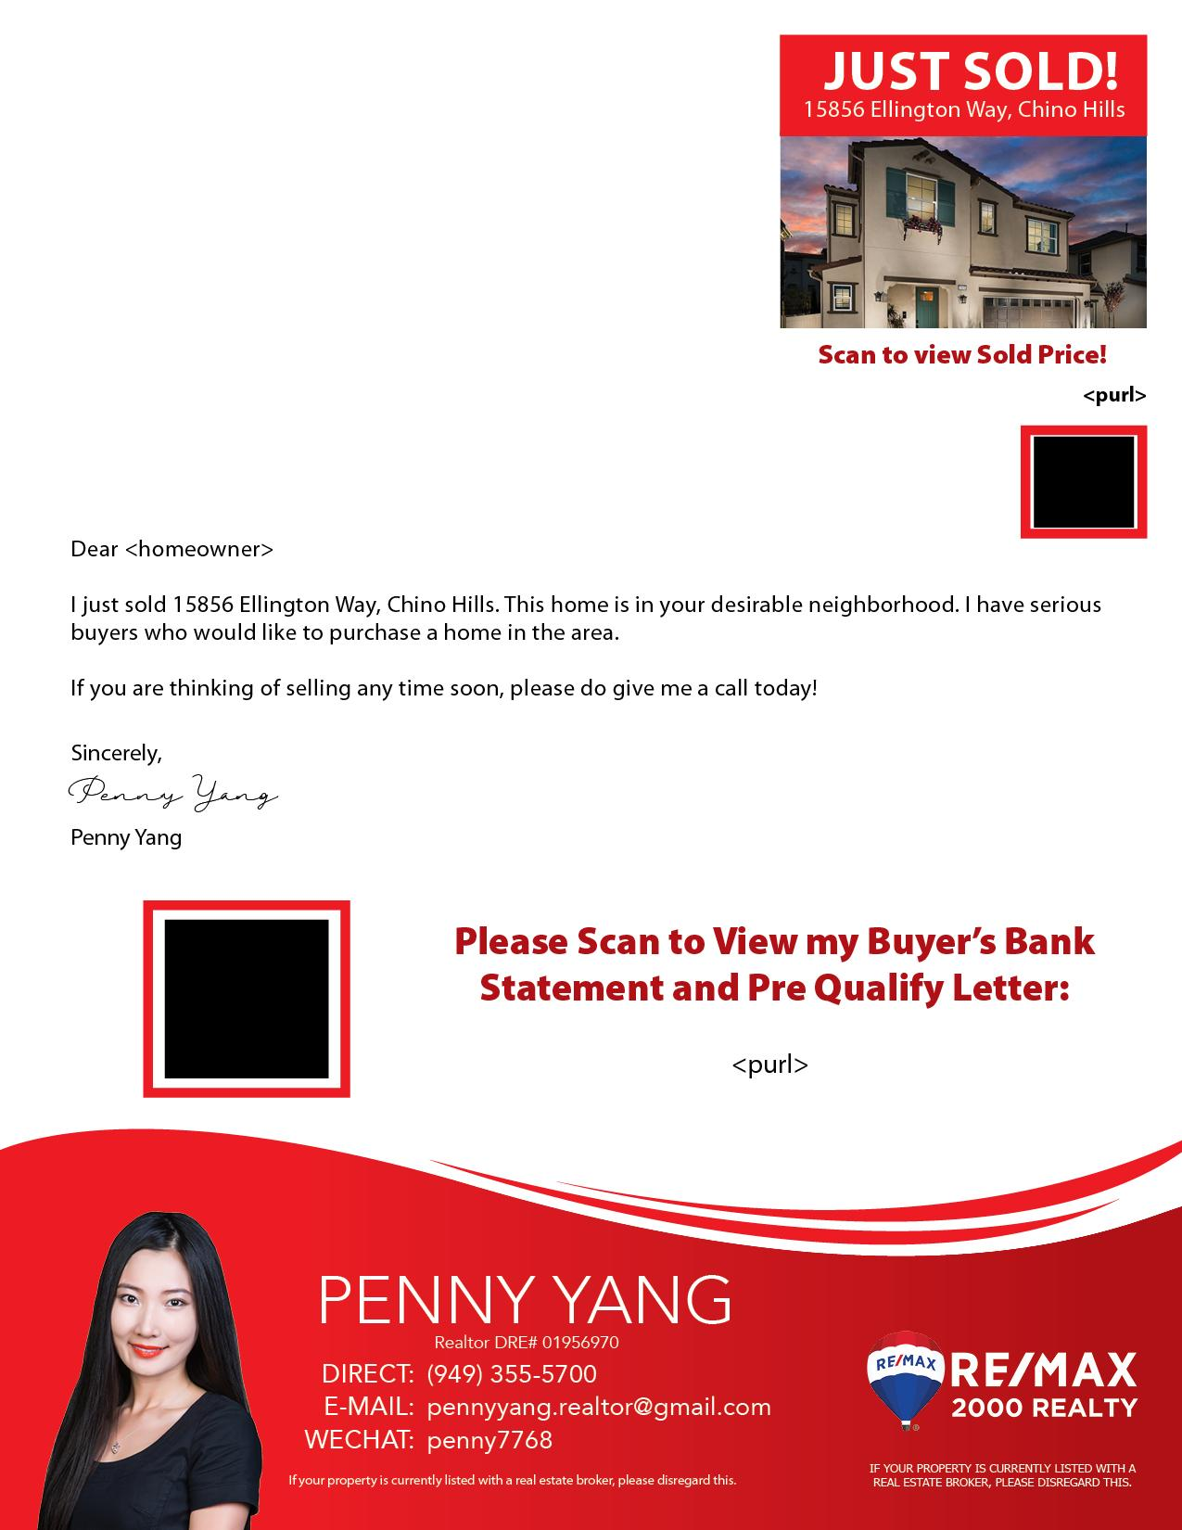
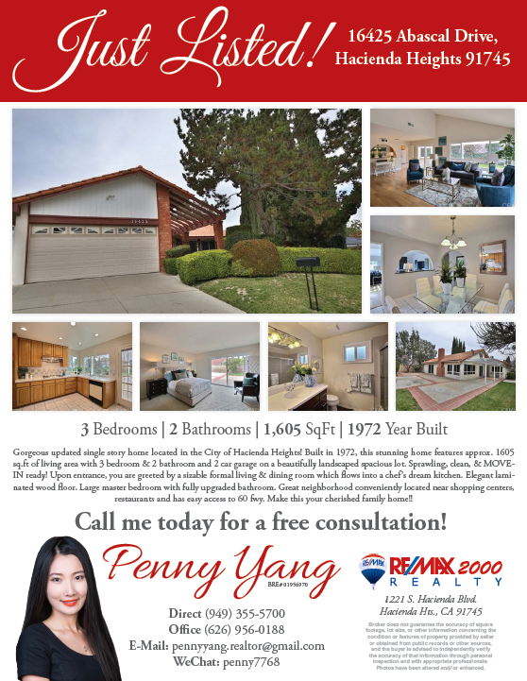

Digital Marketing
YOUR
PROPERTY
Traditional
Marketing
Promotional Letters
Custom Designed flyers
Marketing Report

Slide 3

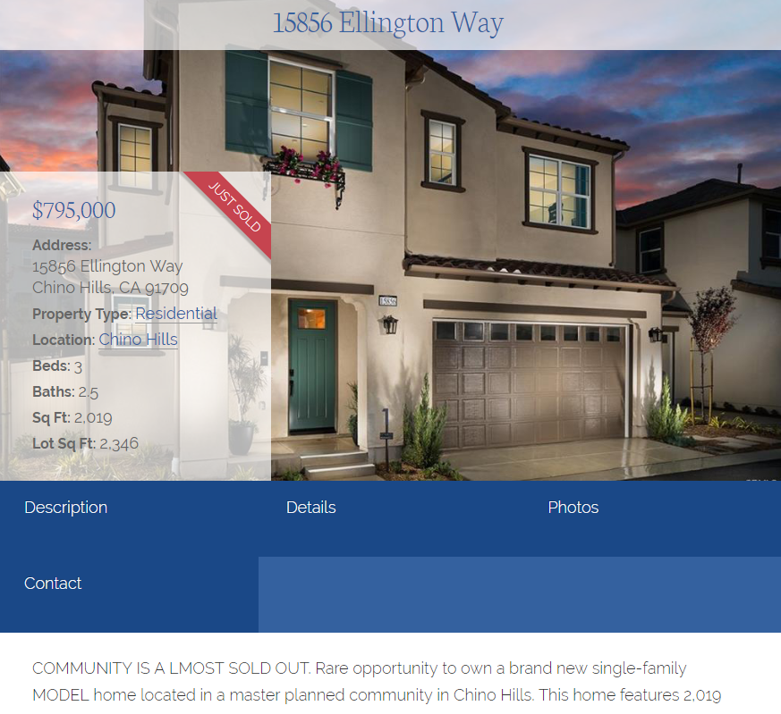
LISTING WEBPAGE
We will create a webpage dedicated just for your listing

Slide 4
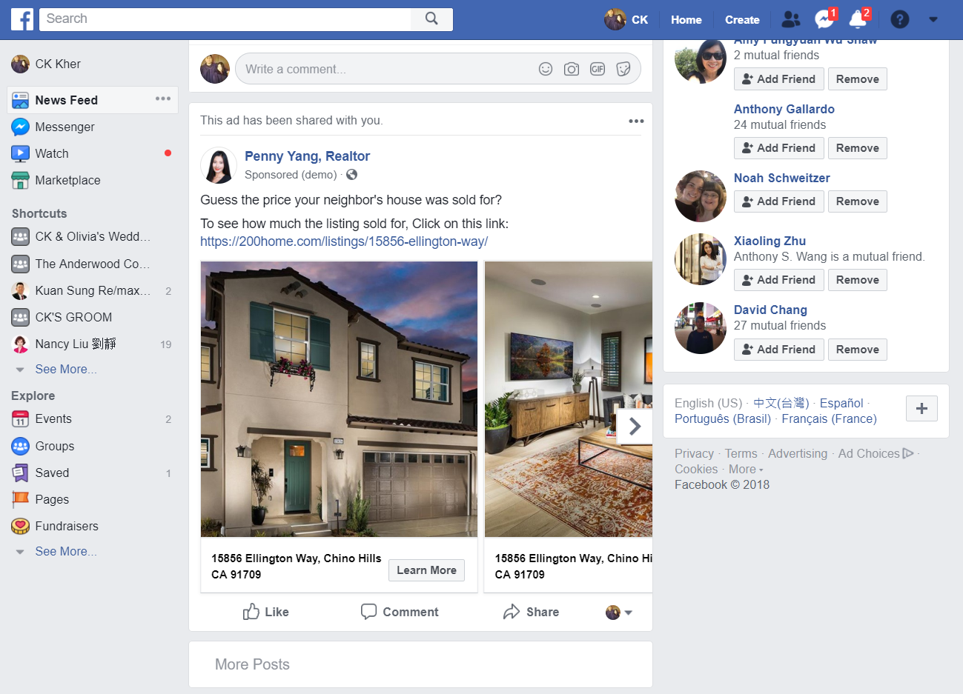
FACEBOOK AD
Your listing shown in front of buyer’s Facebook Newsfeed

Slide 5
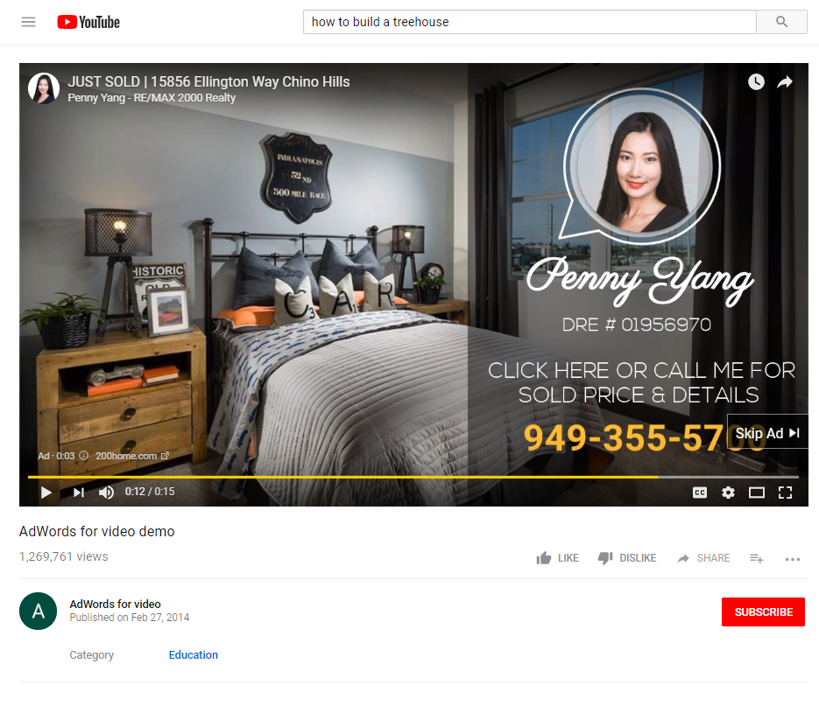
YOUTUBE AD & LISTING VIDEO

Slide 6
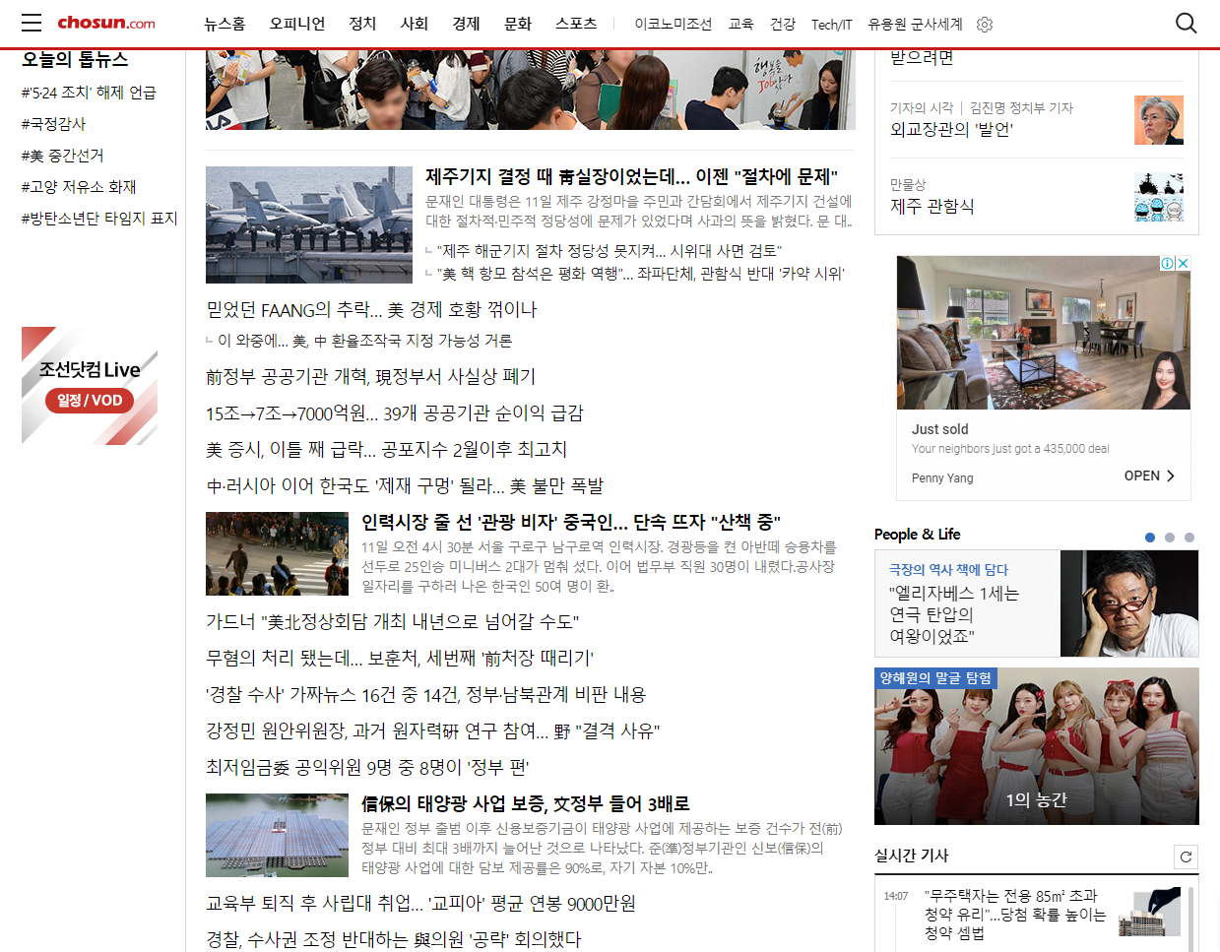
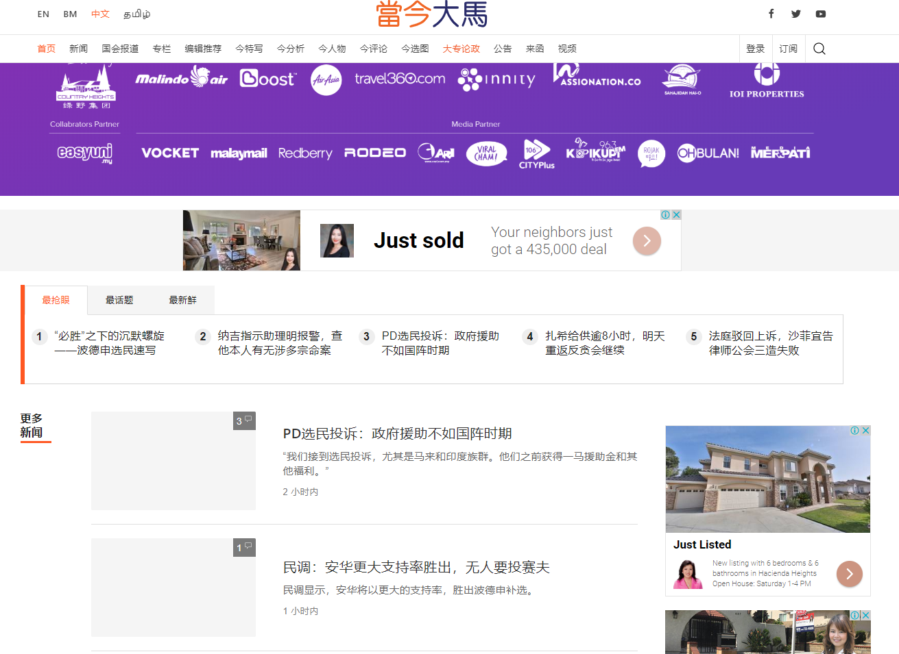
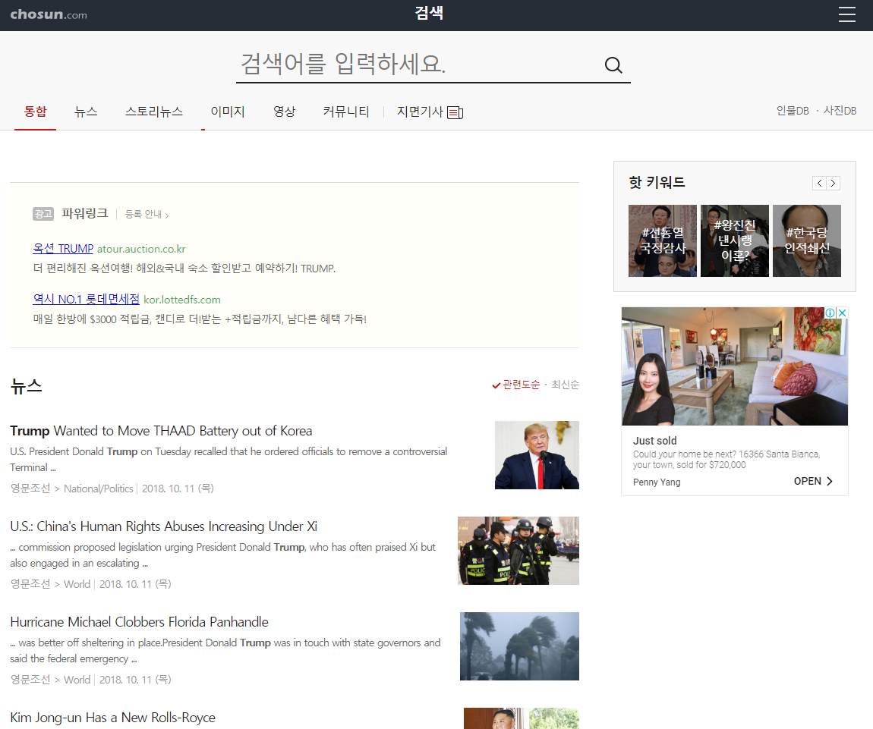
GOOGLE REMARKETING AD
Your property will be seen on 80% of the Worldwide Web.
The remarketing ads retargets interested buyers from the multiple digital ads that we will run.

Slide 7
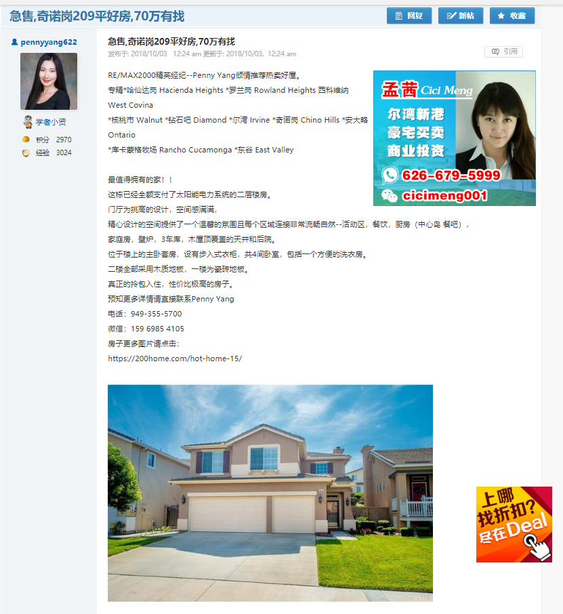
Chinese Classified Ad
Translating and posting listings to Popular Chinese Classified Ad Websites such as chineseinla.com & 58.com.

Slide 8
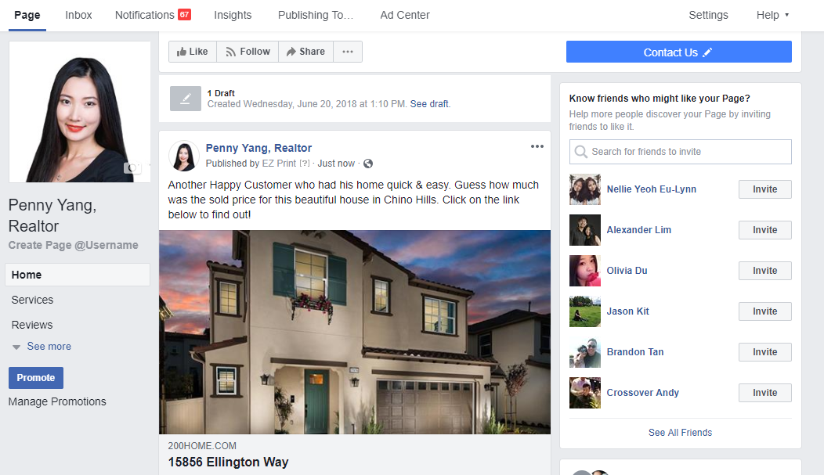
FACEBOOK BUSINESS PAGE
We will share your property on Facebook Business Page

Slide 9
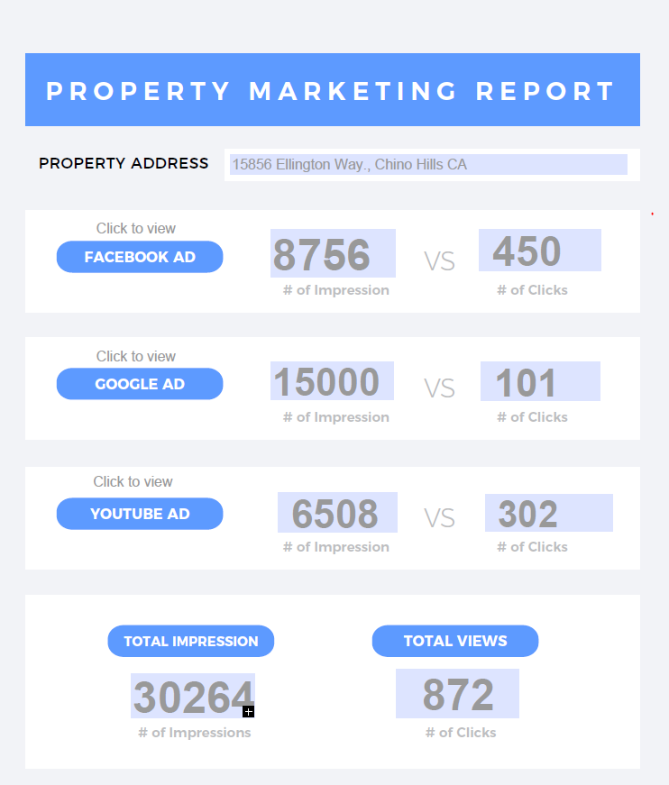
MARKETING REPORTS

Slide 10
COST BREAKDOWN
DIGITAL MARKETING
Facebook Ad $100.00
Google Remarketing Ad $100.00
Youtube Ad $ 100.00
Chinese Classified Ad $ 50.00
Business Page Post $ 30.00
Landing Page $ 30.00
Listing Video $ 80.00
TRADITIONAL MARKETING
Flyer x 50
@ $0.25 per piece $ 30.00
QR Coded Letter x500
@ $0.73 per piece $500.00
Marketing Report $ 50.00
Marketing Cost
$1070.00

Slide 11
Carefully thought, researched & executed marketing campaign to sell your property.

